Slide 1

REST API Development using Java for Robotics Applications

Slide 2

CONTENTS:
Problem Statement
Methodology
Block Diagram
Software Tools Used
API Design & Endpoints

Slide 3
Database,Configurations,Dependencies,Deployment
Working
Future Enhancements
Github Link
Algorithm
JWT Mechanism

Slide 4
ProBLEM STATEMENT
REST API Development using Java for Robotics Applications Building a scalable and efficient REST API using Java for multiple applications. The API
will handle database access, algorithmic computations (such as pathfinding), AI and image
processing. The system will be designed with modular endpoints, allowing seamless integration
with various applications. It will support real-time processing, authentication, and optimized
performance using Java-based frameworks like Spring Boot.

Slide 5
Methodology
1.Set up the Spring Boot project in intellije ide,necessary dependencies,java21
2.Design and implement REST API and endpoints which takes request and responses in json.
3.Develop a grid-based shortest path algorithm.
4.Use H2 in-memory database and other confiqurations.
5.Implement JWT authentication for authorizated and authenticated API access.
6.Test the API and security functionality using Postman.

Slide 6
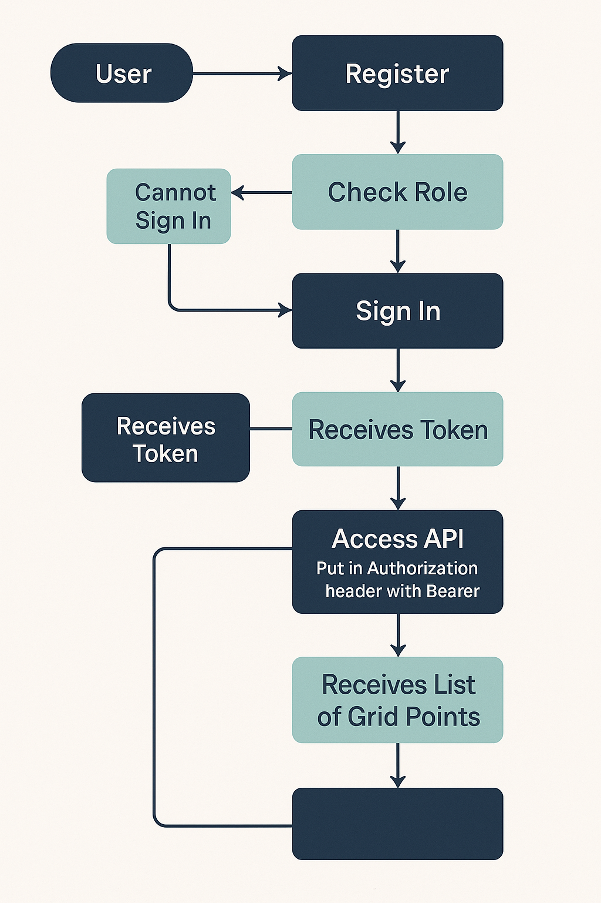
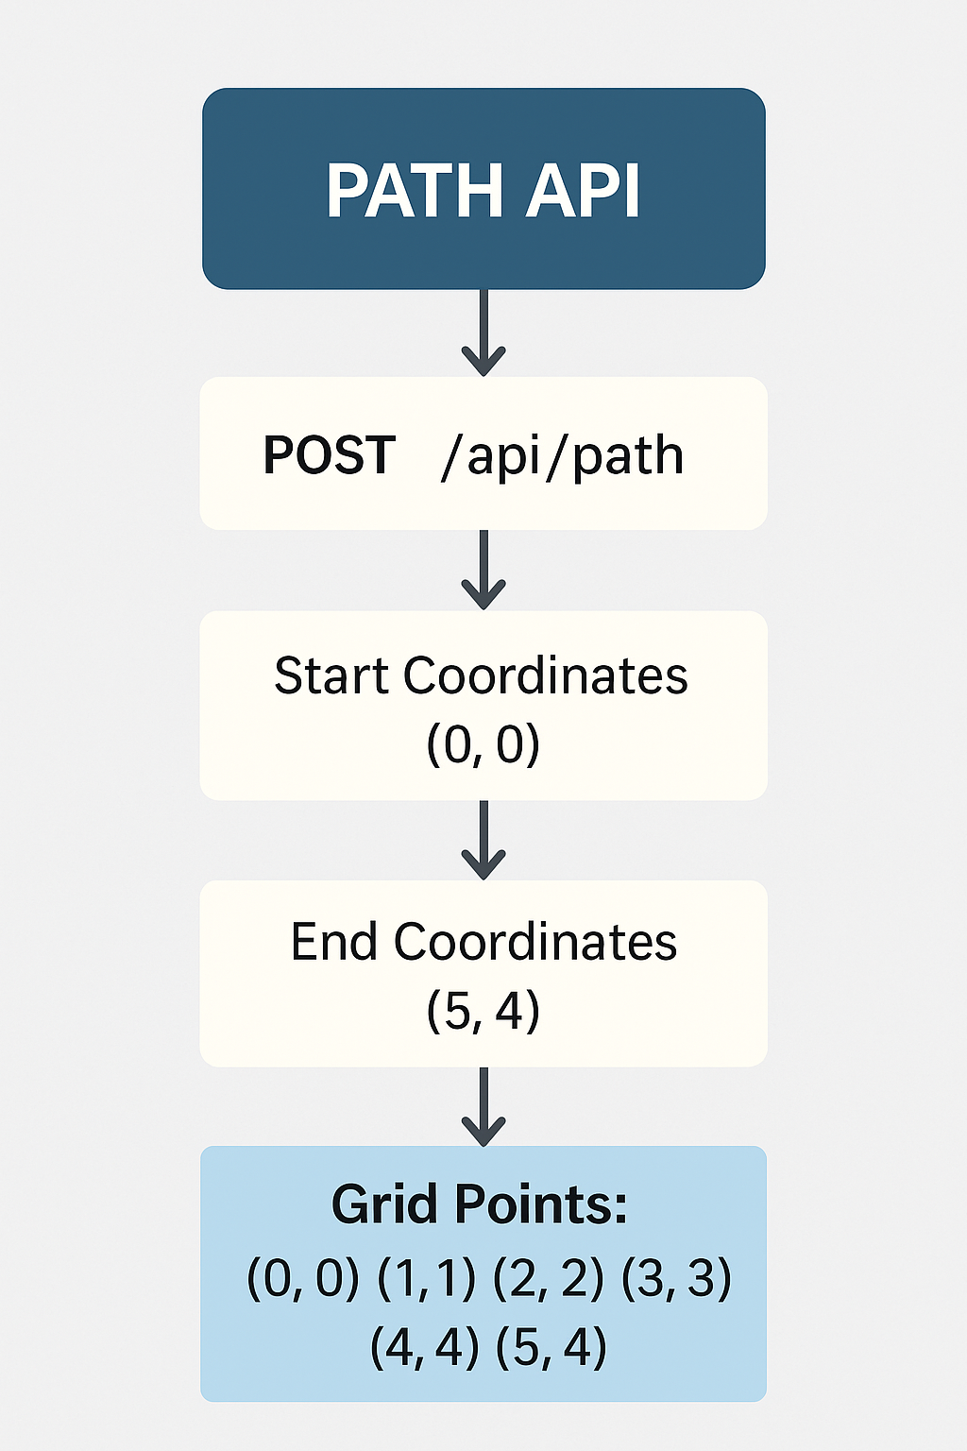
BLOCK DIAGRAM

Slide 7
SOFTWARE TOOLS USED:
Intellij IDEA
Postman
SpringBoot
Spring Security,Spring JPA
H2 Datbase,Lombok
Maven
Java 24,Github

Slide 8
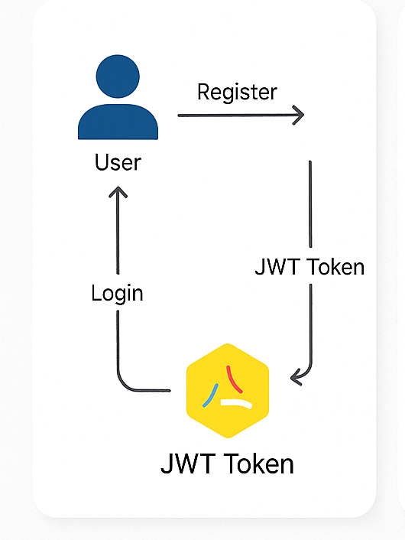
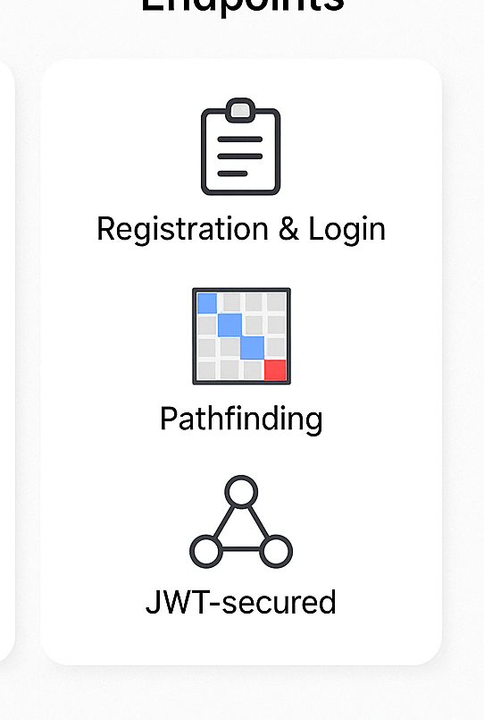
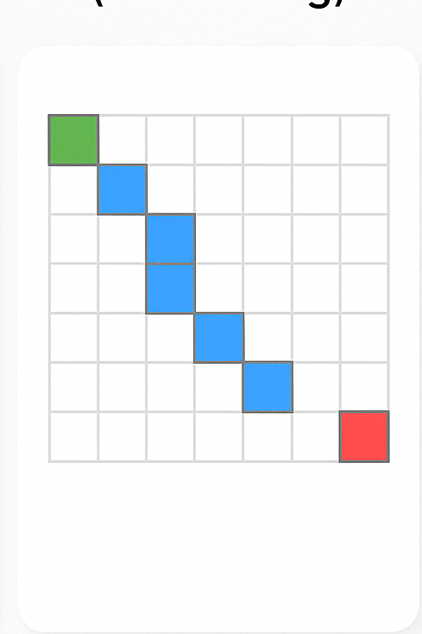
















Project Breakdown
API DESIGN AND ENDPOINTS
SHORTEST PATH ALGORITHM
JWT
MECHANISM

Slide 9
API DESIGN AND ENDPOINTS
PATH MODEL | PATH DTO | PATH SERVICE | PATH CONTROLLER | PATH REPOSITORY
@Id @GeneratedValue private Long id; private int startX; private int startY; private int endX; private int endY; private String pathPoints; | @Data public class PathRequest { private int startX; private int startY; private int endX; private int endY; } | 1.Algorithm 2. @Autowired private PathRepository pathRepository; 3.Methods to generate path,get all path,calculate and save all path using the path repository object. | @RestController @RequestMapping("/api/path") public class PathController { @Autowired private PathService pathService; @PostMapping public Path calculateAndSavePath(@RequestBody PathRequest request) @GetMapping public List<Path> getAllPaths() { return pathService.getAllPaths(); } | public interface PathRepository extends JpaRepository<Path, Long> { }

Slide 10
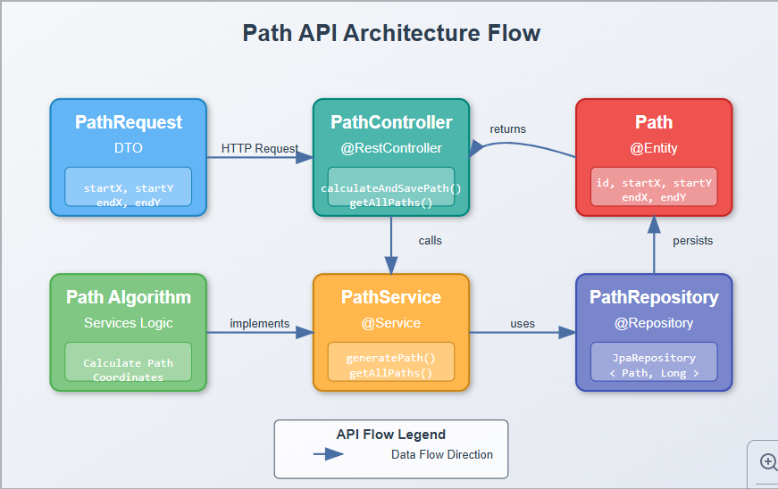

Slide 11
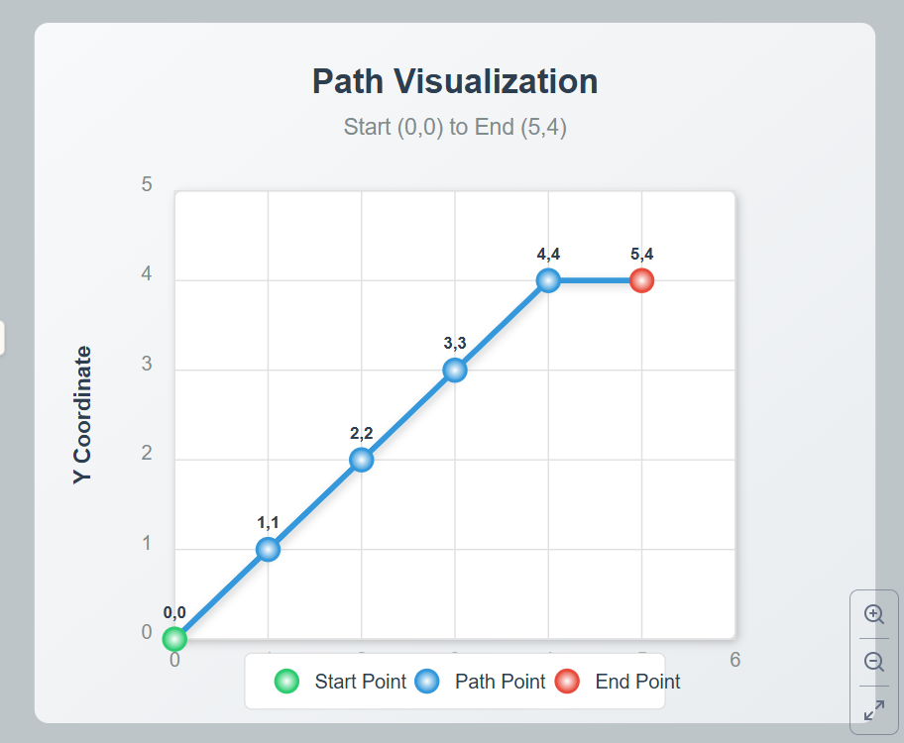
SHORTEST PATH ALGORITHM
Determine Movement Direction The algorithm starts by figuring out how to move from the start to the end point using int dx = Integer.compare(x, i); and int dy = Integer.compare(y, j); which decide if movement along each axis should be +1, -1, or 0.
Initialize the Path A list is created to hold the path using List<Point> path = new LinkedList<>();, and the
starting point is added with path.add(new Point(p, q));.
Traverse Step-by-Step A while loop while (p != x || q != y) runs until the destination is reached. Inside, it moves diagonally
when both p != x and q != y by
incrementing p += dx and q += dy, or straight when only one direction remains.
After every move, path.add(new Point(p, q)); records the step.
Complete Path Generation The loop continues until the current point matches the target. The final path list contains the shortest
path made of Point objects from start to end, allowing smooth and efficient traversal.

Slide 12
SHORTEST PATH ALGORITHM
public static List<Point> generatePath(int i, int j, int x, int y) {
List<Point> path = new ArrayList<>();
int p = i, q = j, dx = Integer.compare(x, i), dy = Integer.compare(y, j);
path.add(new Point(p, q));
while (p != x || q != y) {
if (p != x) p += dx;
if (q != y) q += dy;
path.add(new Point(p, q));
}
return path;
import java.awt.Point;
import java.util.ArrayList;
import java.util.List;
import java.util.Scanner;
public class PathGenerator {
public static void main(String[] args) {
Scanner scanner = new Scanner(System.in);
int startX = scanner.nextInt(), startY = scanner.nextInt(), endX = scanner.nextInt(), endY = scanner.nextInt();
for (Point point : generatePath(startX, startY, endX, endY)) {
System.out.print("(" + point.x + "," + point.y + ") ");
}
}
}
}

Slide 13
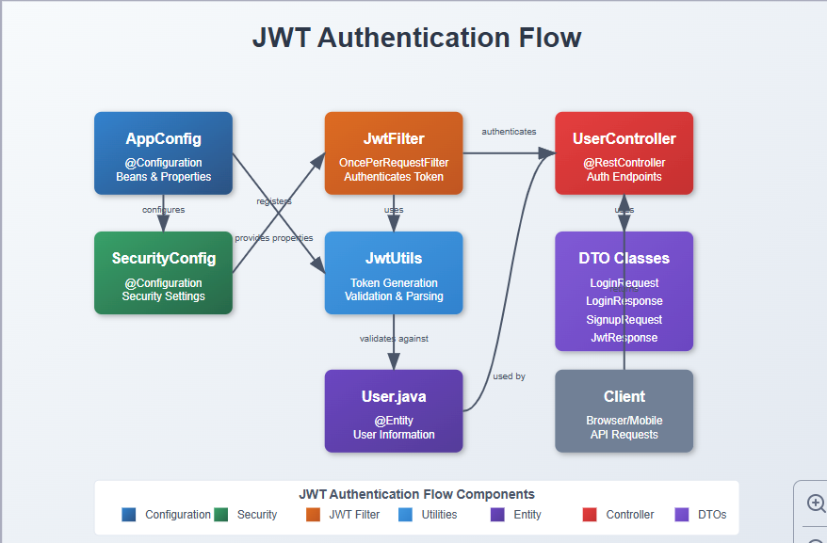
JwT MECHANISM
Header | Payload | Signature
{ "alg": "HS256", "typ": "JWT" } | { "sub": "john.doe", "name": "John Doe", "role": "admin) "iat": 1614560983, "exp": 1614564583 } | Signature = HMACSHA256( base64UrlEncode(header) + "." + base64UrlEncode(payload), secret)

Slide 14
JwT MECHANISM
APP CONFIG | JWTUtil | Security Configurations | User | User Controller | JWTFilter | DTO | User repository
Defines how Spring Security loads user details (username, password, role) from the database during authentication. 4o | generating, extracting, and validating JWT tokens using a secret key and claims. | Spring Security filter chain, disables CSRF, sets up authorization rules, and adds the JWT filter. | Entity class representing a user with fields like username, password, and role, stored in the database. | Exposes endpoints for user registration and login; returns JWT on successful login. | Intercepts requests, extracts JWT from headers, validates it, and sets the authenticated user in SecurityContext. | Java objects for transferring data between client and server during registration and login. | UserRepository interface handles database operations for the User entity and throws an exception if a user is not found by username.

Slide 15
Database AND Configurations,
manage and access relational data using Java objects.
1.DATABASE:
H2 in-memory used to store data like users, tokens,paths etc.
2.JPA:Manage and access relational data
3.Hibernate:A popular JPA implementation that translates Java code (entities) into SQL and interacts with the database.
jpa cant happen without hibernate jpa is a interface and hibernate implements it
5. JDBC Driver:va Database Connectivity driver that enables Java apps to connect and communicate with databases (like the H2 driver here).
spring.application.name=JWT #spring.datasource.url=jdbc:h2:mem:testdb #spring.datasource.driverClassName=org.h2.Driver #spring.datasource.username=sa #spring.datasource.password= #spring.jpa.database-platform=org.hibernate.dialect.H2Dialect #spring.h2.console.enabled=true #spring.jpa.hibernate.ddl-auto=update #logging.level.org.hibernate.SQL=debug

Slide 16
DEPENDENCIES AND DEPLOYMENT
DEPENDENCIES
Spring Boot Starter Web
Spring Boot Starter Security
Spring Boot Starter Data JPA
h2
lombok
spring-boot-devtools
spring-boot-starter-test
spring-security-test
jjwt-api
jjwt-impl
jjwt-jackson
APPLICATION FILE:
@SpringBootApplication
SpringApplication.run(classname);
The application is deployed locally and runs on embedded tomcat server at http://localhost:8080

Slide 17
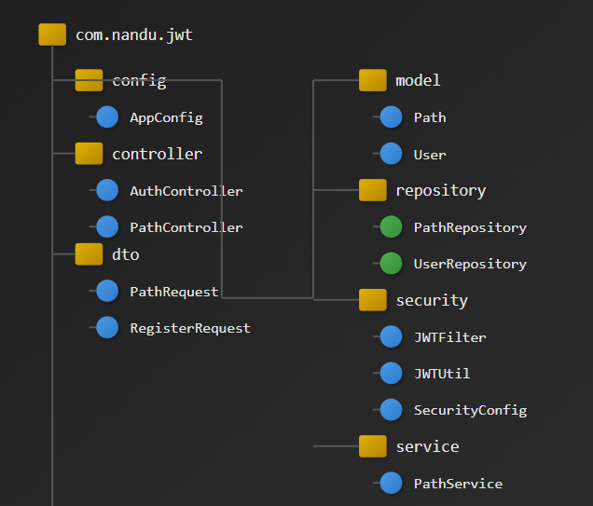
WORKINg(POSTMAN)
Register User POST /auth/register
json
{ "username": "john", "password": "1234", "role": "ROLE_USER" }
Login for Token POST /auth/login
json
{ "username": "john", "password": "1234" }
➜ Response: { "token": "..." }
Access Path API POST /api/path Header: Authorization: Bearer <token>
json
{ "robotId": "R1", "startX": 0, "startY": 0, "endX": 5, "endY": 54}
➜ Response: Computed shortest path
asnx

Slide 18
FUTURE ENHANCEMENTS:
Real Database like SQL
Advance algorithms for pathfinding like Dijkstra,AI and Image Processing
Real Time Processing by Web Socket
Cloud Deployment
Frontend Integration to interact with the api

Slide 19



GITHUB LINK:
https://github.com/nandini-3006/RNXG/tree/master

Slide 20

Thank You
By
Nandini

